Slide 1
Natural Language Processing Hands-on 3
2017/12/14
How-Jen Tzou

Slide 2
What you will do in Hands-on 3
Co-op with your final project team member and create a website together

Slide 3
What kind of website you need to create
You need to create a website that could display your questions and collect answers from users.(Just like Google Form)
Your website needs to be compatible with Amazon Mechanical Turk’s

Slide 4
Amazon Mechanical Turk and External Question
You host you website at https://www.my.page/index.html
When you are using external question on Mturk, workers access you website through https://www.my.page/index.html?workerId=XXX&hitId=XXX&assignmentId=XXX&turkSubmitTo=XXX

Slide 5
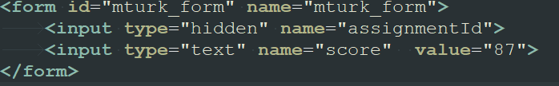
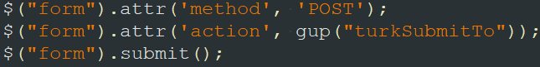
Two important variables
You must submit the assignmentId field to the url given by turkSubmitTo.

Slide 6
What does the website look like?

Slide 7
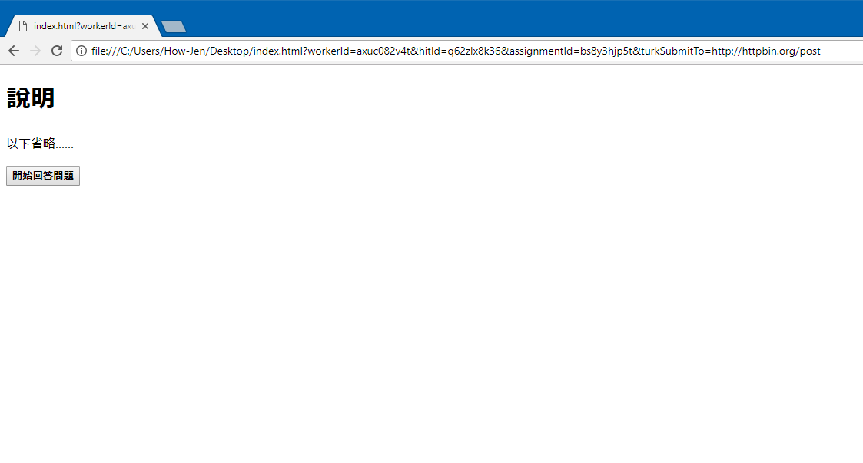
You need to provide a decent instruction about your task.

Slide 8


Slide 9


Slide 10
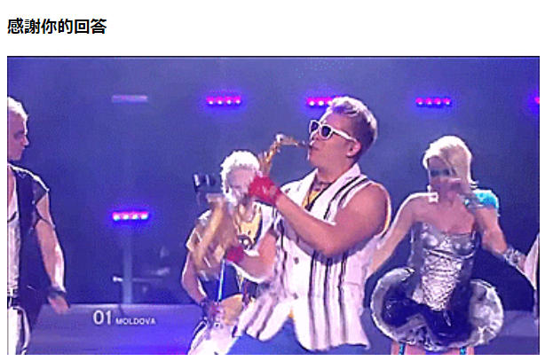
Once the form is submitted, you need to prevent the
worker from re-submitting the form.

Slide 11
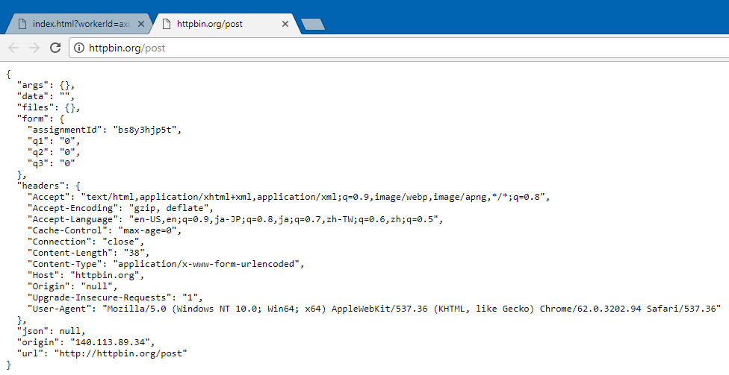
If you post your form to http://httpbin.org/post properly,
your browser should show this page.

Slide 12
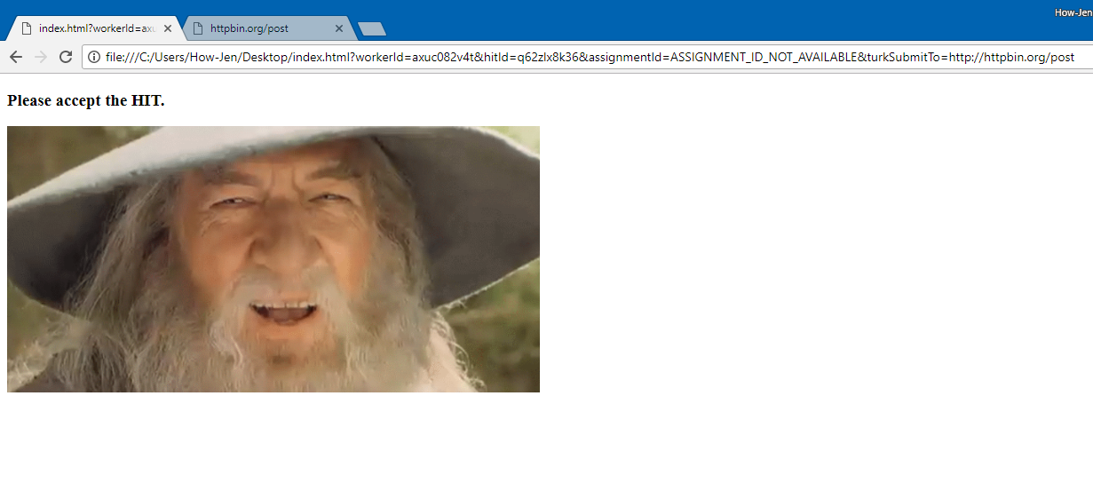
If assignmentID= ASSIGNMENT_ID_NOT_AVAILABLE,
show preview message

Slide 13
Debugging
Append ?workerId=axuc082v4t&hitId=q62zlx8k36&assignmentId=bs8y3hjp5t&turkSubmitTo=http://httpbin.org/post to the end of the web address when opening your website
Remember to try ?workerId=axuc082v4t&hitId=q62zlx8k36&assignmentId=ASSIGNMENT_ID_NOT_AVAILABLE&turkSubmitTo=http://httpbin.org/post as well

Slide 14
Grading Criteria
If you achieve all the basic requirements (like the one in the slides), you get 8 points
If you implement a task completion timer in your website (i.e. workers need to spend at least an amount of time completing each task), you get additional 2 points.
If you have elegant web design, or you add some useful function to your website, you get bonus points

Slide 15
Submission
Submit you code to https://goo.gl/forms/0yNjP0KsKybu3ca12
Pack your work into a zip file before submitting it. Remember to name you file as GroupXX.zip
In-class submission deadline is 12/17 23:59
Late submission deadline is 12/21 23:59

